Slide 1
Office 365 Development
October 2014

Slide 2


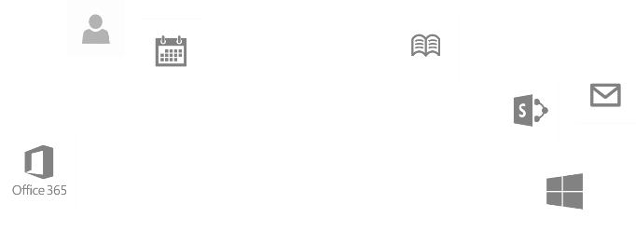
Recap
Introduction to Office 365 development
Module 1: Introduction to Office 365 development
Module 2: Getting started with Apps for Office
Module 3: Getting started with Apps for SharePoint
Module 4: Moving Full Trust Code to the Cloud Using Repeatable Patterns and Best Practices
Module 5: Getting started with the Office 365 APIs
dev.office.com/training

Slide 3
Course Agenda
Deep Dive into Integrating Office 365 APIs with Web Applications
Module 1: Deep Dive into Azure AD with the Office 365 APIs
Module 2: Deep Dive into Office 365 APIs for Calendar, Mail, and Contacts
Module 3: Deep Dive into Office 365 APIs for OneDrive for Business
Module 4: Deep Dive into Office 365 APIs for SharePoint Site services
Module 5: Deep Dive into Office 365 APIs for Yammer services
Module 6: Deep Dive into Office 365 APIs for Office Graph
Module 7: Deep Dive into Office 365 APIs for OneNote services

Slide 4
Deep Dive into Office 365 APIs for Calendar, Mail, and Contacts
Speaker
Speaker

Slide 5

Agenda
Overview
Connected Services
Paging Support
CRUD Support
Exchange Operations using REST

Slide 6
Overview

Slide 7
Office 365 APIs for Calendar, Mail and Contacts
Office 365 APIs
Mail Message API
Calendar Events API
Contacts API
Office 365 APIs accessible through REST
https://outlook.office365.com/ews/odata/Me/Inbox/Messages
https://outlook.office365.com/ews/odata/Me/Events
https://outlook.office365.com/ews/odata/Me/Contacts
Office 365 APIs accessible through ExchangeClient library
A library which abstracts away sending and receiving REST request

Slide 8
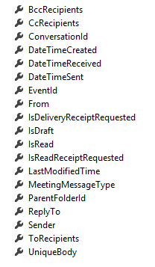
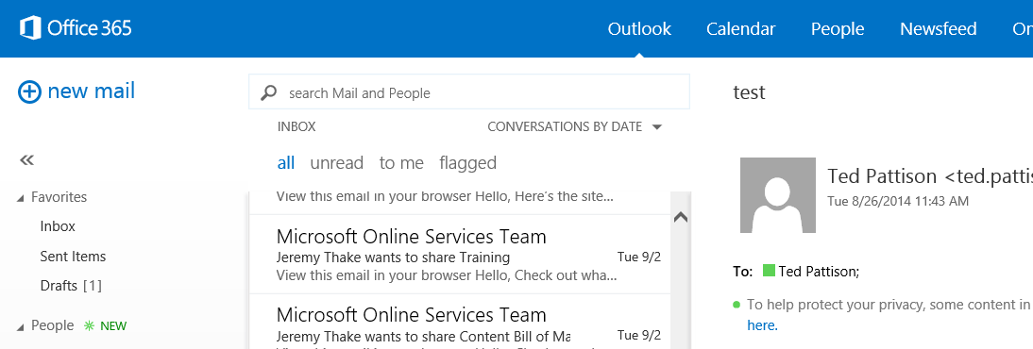
Mail Messages
Message
Common API operations
Reading messages
Deleting messages
Sending messages
Working with attachments

Slide 9
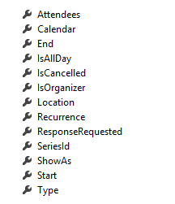
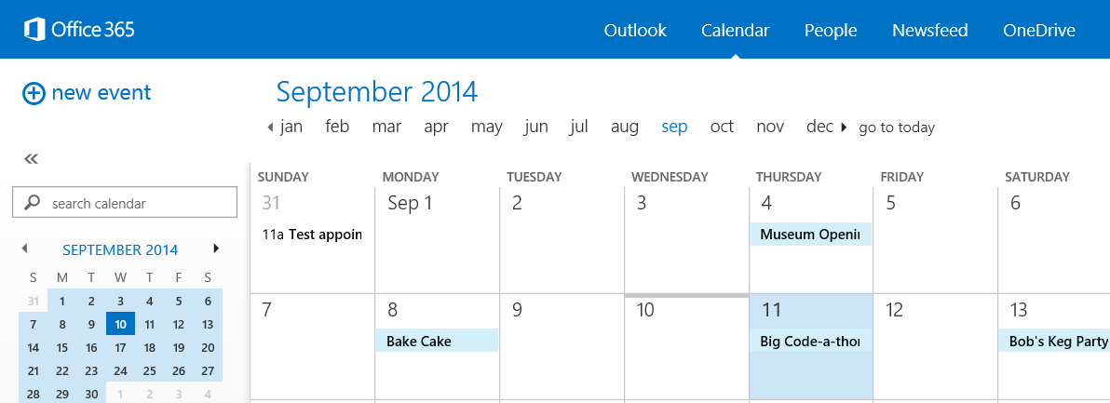
Calendar Events
Common API operations
Reading events for specific date range
Creating events
Deleting events
Editing events
Event

Slide 10
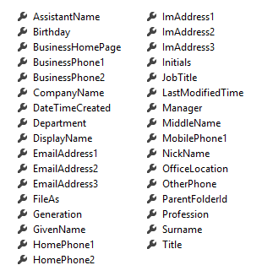
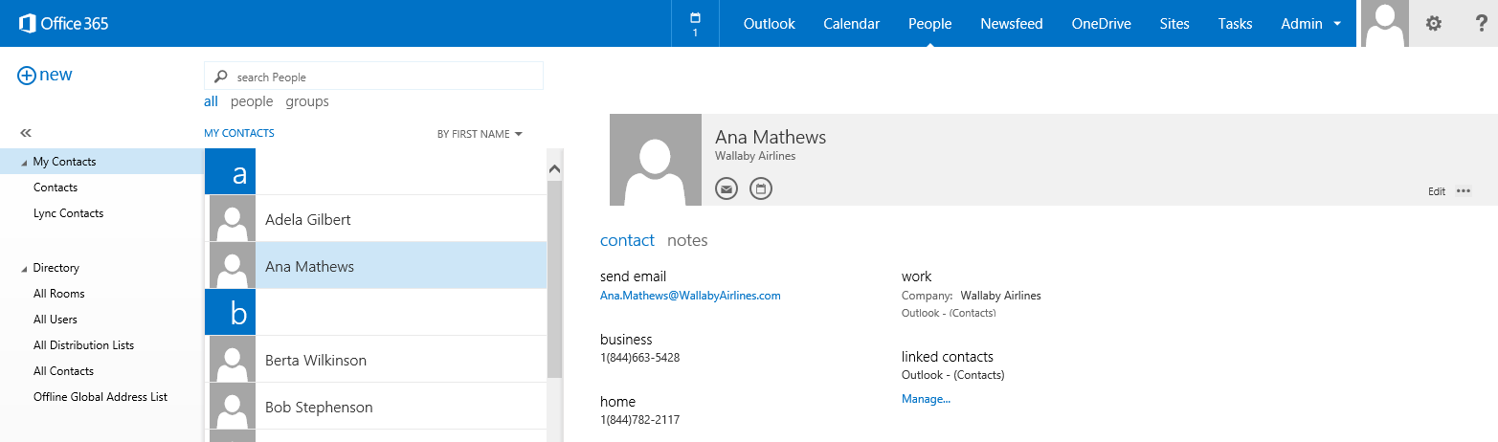
Contacts
Common API operations
Reading contacts
Searching for contacts
Creating contacts
Deleting contacts
Editing events
Contact

Slide 11
Connected Services

Slide 12
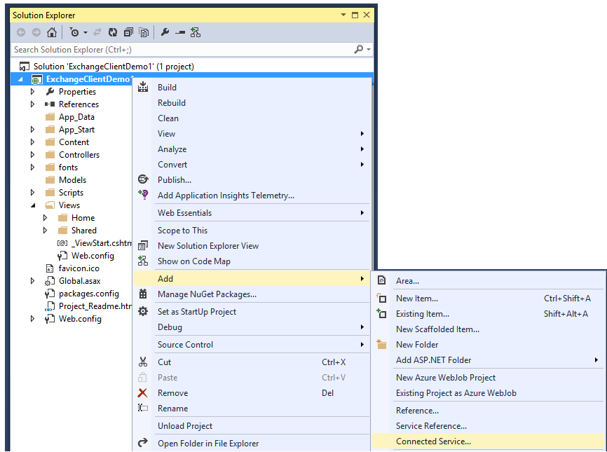
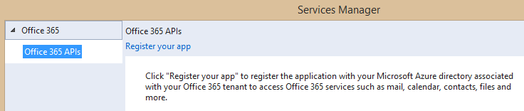
Adding Connected Services
1
Project > Add > Connected Service…
2
Register your app

Slide 13
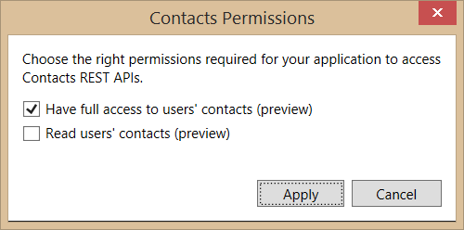
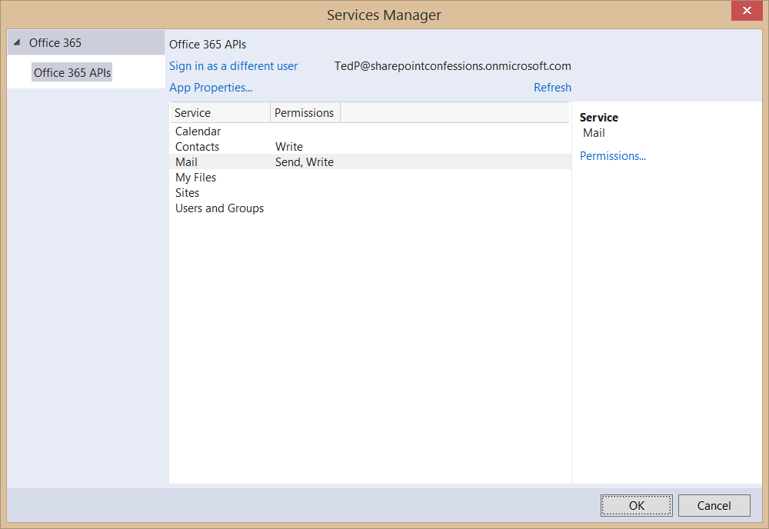
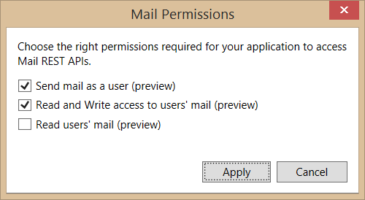
Connected Services Permissions
3
Select required app permissions

Slide 14
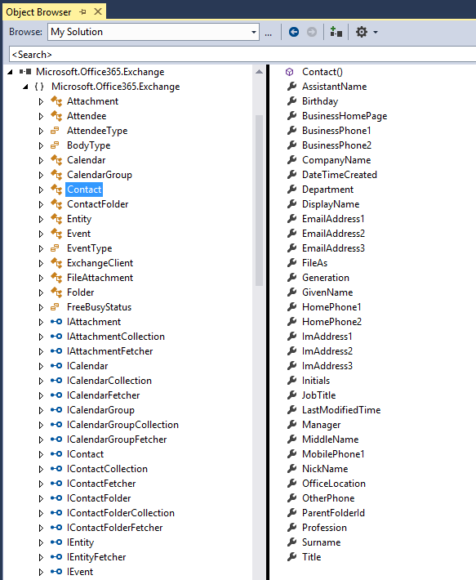
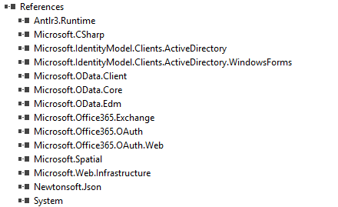
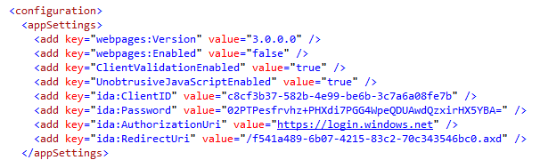
Projects with Connected Services
Assemblies added with a Connected Service
Microsoft.Office365.OAuth
Microsoft.Office365.Oauth.Web
Microsoft.Office365.Exchange
AppSettings added with a Connected Service

Slide 15
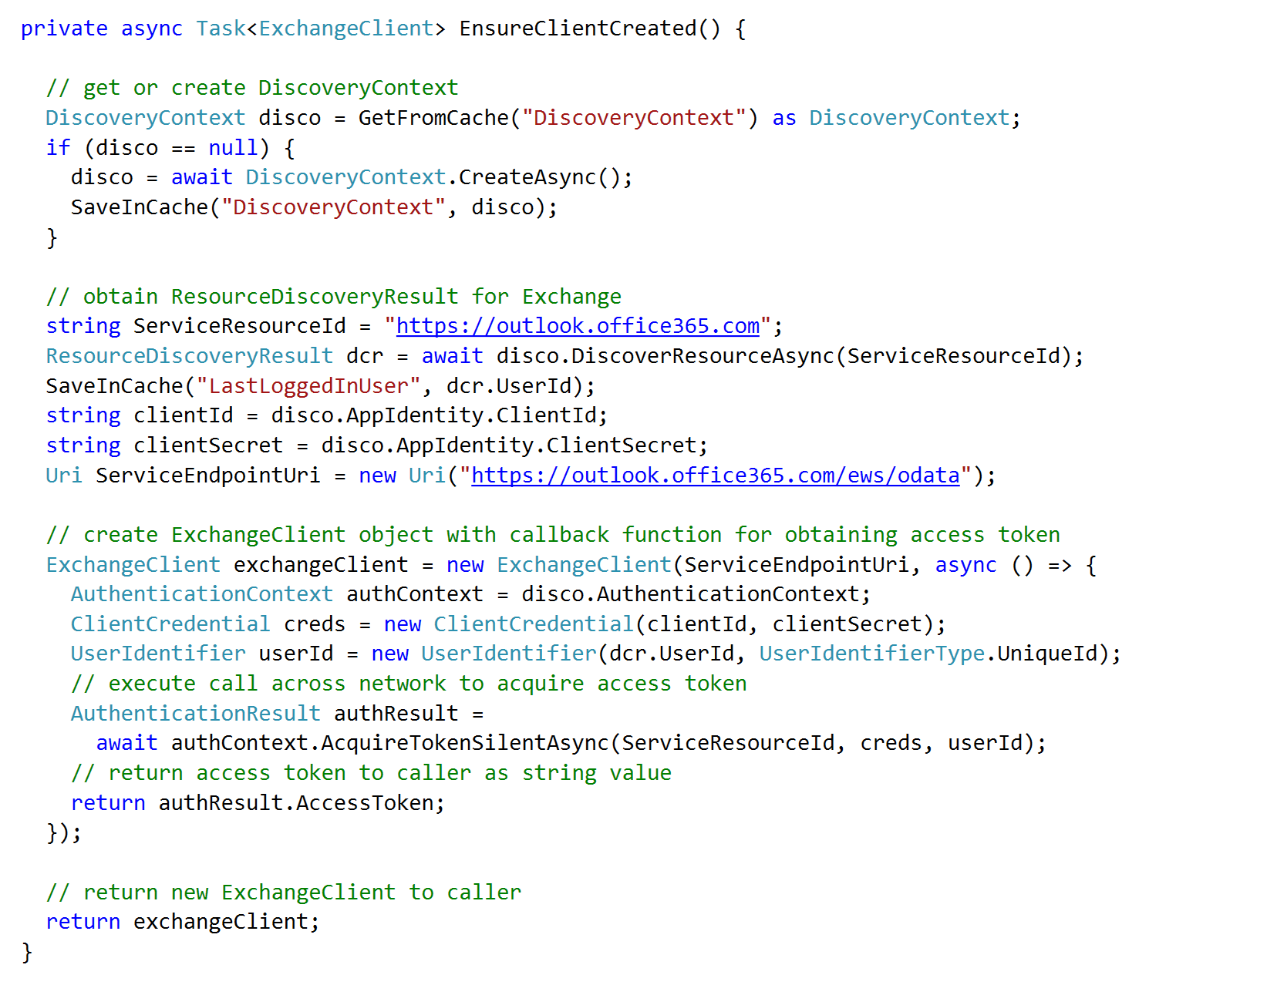
Discovery service resource using DiscoverResourceAsync
Retrieve access token using AcquireAccessTokenSlientAsync

Slide 16
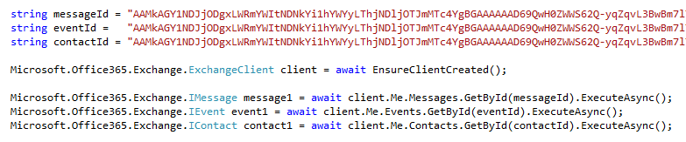
Programming with ExchangeClient
ExchangeClient provide Me property
Provides access to mail, events and contacts of currently logged in user
Explicit calls used (e.g. ExecuteAsync) to call across network to Office 365 service

Slide 17
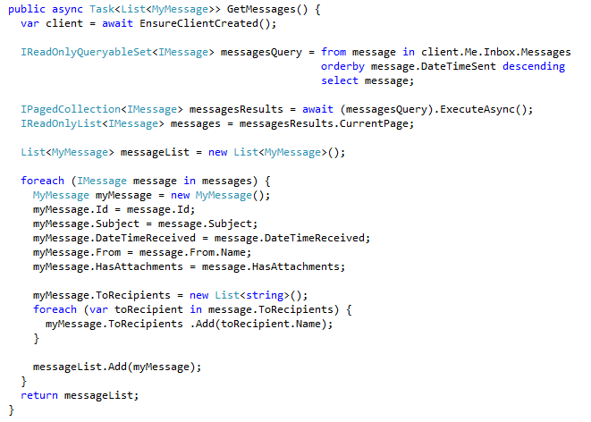
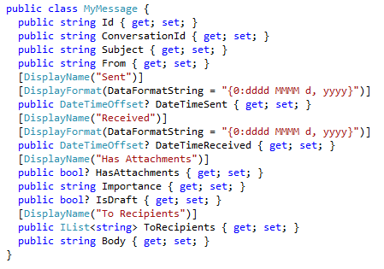
Retrieving Messages

Slide 18
demo
Creating an MVC Project that uses Connected Services

Slide 19
Paging Support

Slide 20
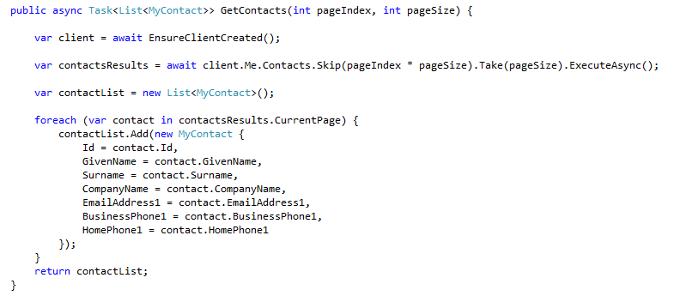
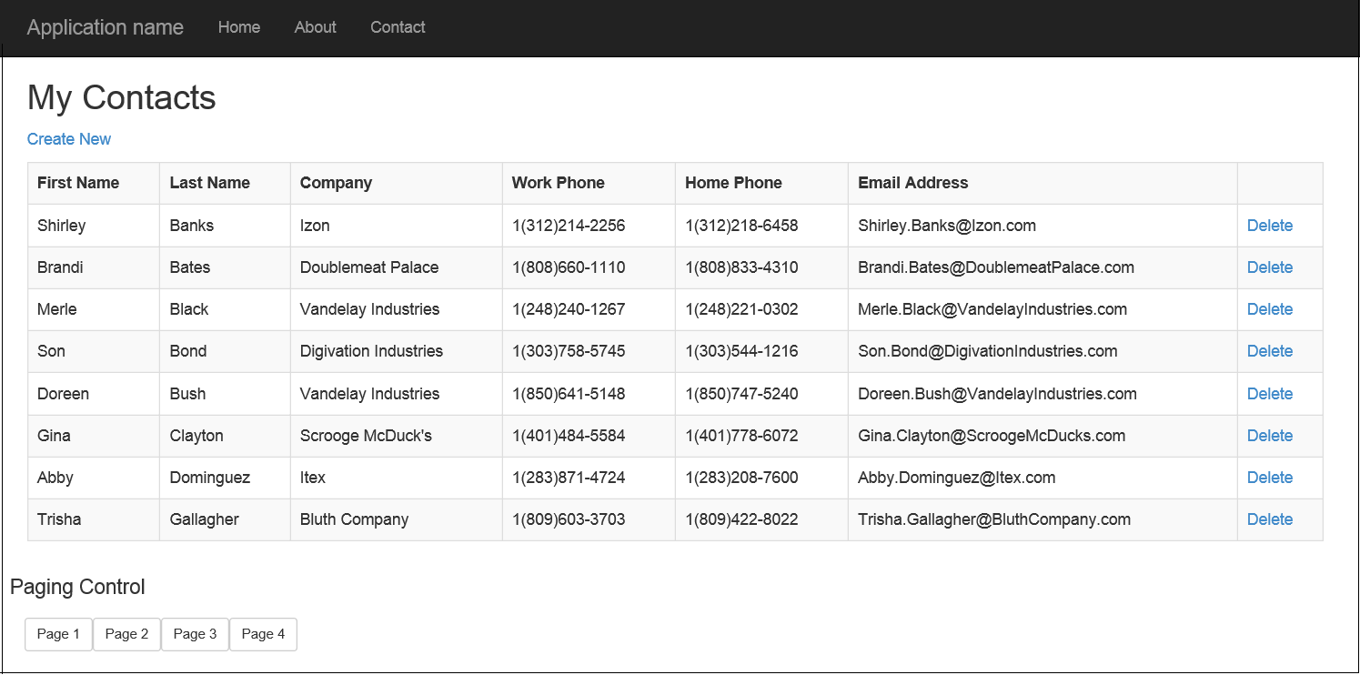
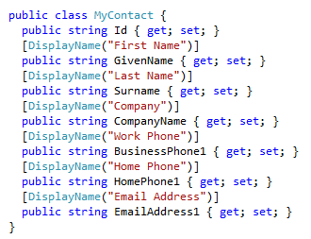
Paging with the Office 365 APIs
Limit the number of items returned by using the Take() and Skip() prior to ExecuteAsync()
Paging buttons call GetContacts which skips over the specified number of contacts to present the next page

Slide 21
demo
Examining Paging Support with ExchangeClient

Slide 22
CRUD Support

Slide 23
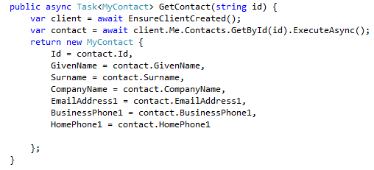

Getting and Deleting a Specific Contact
Contact retrieved by calling GetById()
Contact deleted by calling DeleteAsync() on Contact object

Slide 24
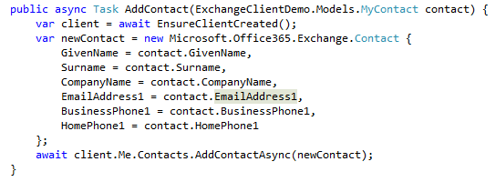
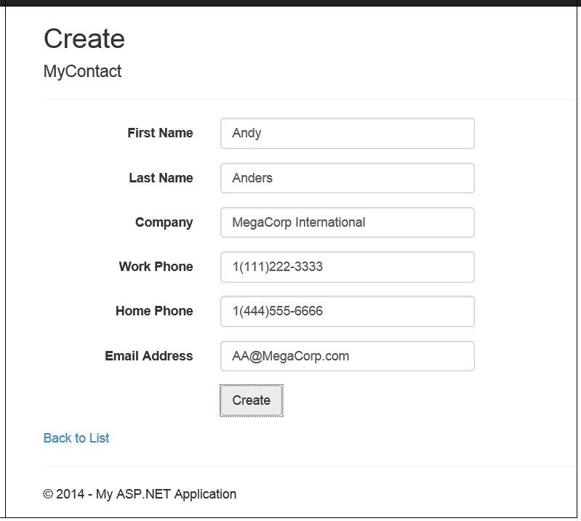
Adding a Contact
Call AddContactAsync() on Contacts collection

Slide 25
demo
Update operations with the EXCHANGEClient

Slide 26
Exchange Operations with REST

Slide 27
Office 365 Exchange REST APIs
https://outlook.office365.com/ews/odata/Me/RootFolder
https://outlook.office365.com/ews/odata/Me/Inbox
https://outlook.office365.com/ews/odata/Me/Inbox(<message_id>)
https://outlook.office365.com/ews/odata/Me/Drafts
https://outlook.office365.com/ews/odata/Me/SentItems
https://outlook.office365.com/ews/odata/Me/DeletedItems
https://outlook.office365.com/ews/odata/Me/Events
https://outlook.office365.com/ews/odata/Me/Events(<event_id>)
https://outlook.office365.com/ews/odata/Me/Calendar
https://outlook.office365.com/ews/odata/Me/Calendar/Events
https://outlook.office365.com/ews/odata/Me/Calendars(<calendar_id>)/Events
https://outlook.office365.com/ews/odata/Me/Contacts
https://outlook.office365.com/ews/odata/Me/Contacts(<contact_id>)

Slide 28
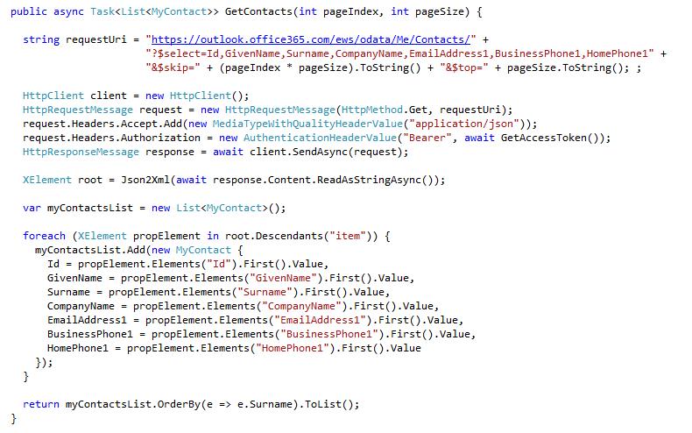
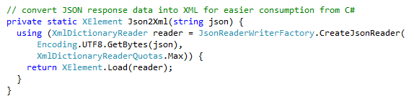
Reading Contacts using REST
Send GET request to Contacts endpoint
Office 365 Exchange API only returns JSON responses
Paging is accomplished using $skip and $top
Notes:
No support for $skip and $orderby so paging is post-query

Slide 29
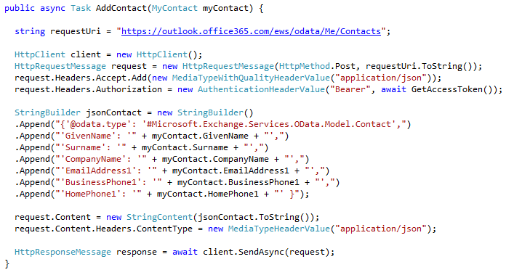
Adding a new Contact
POST to Add endpoint
Provide minimum of @data.type and GivenName property

Slide 30
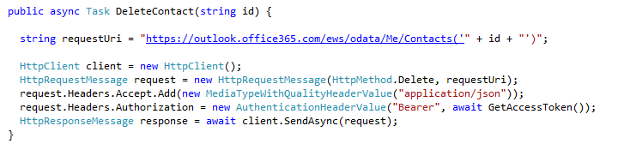
Deleting a Contact
DELETE operation targeting Me/Contacts(Id)

Slide 31
demo
Exchange Operations using the Office 365 REST APIs

Slide 32
Summary
Overview
Connected Services
Paging Support
CRUD Support
Exchange Operations using REST

Slide 33
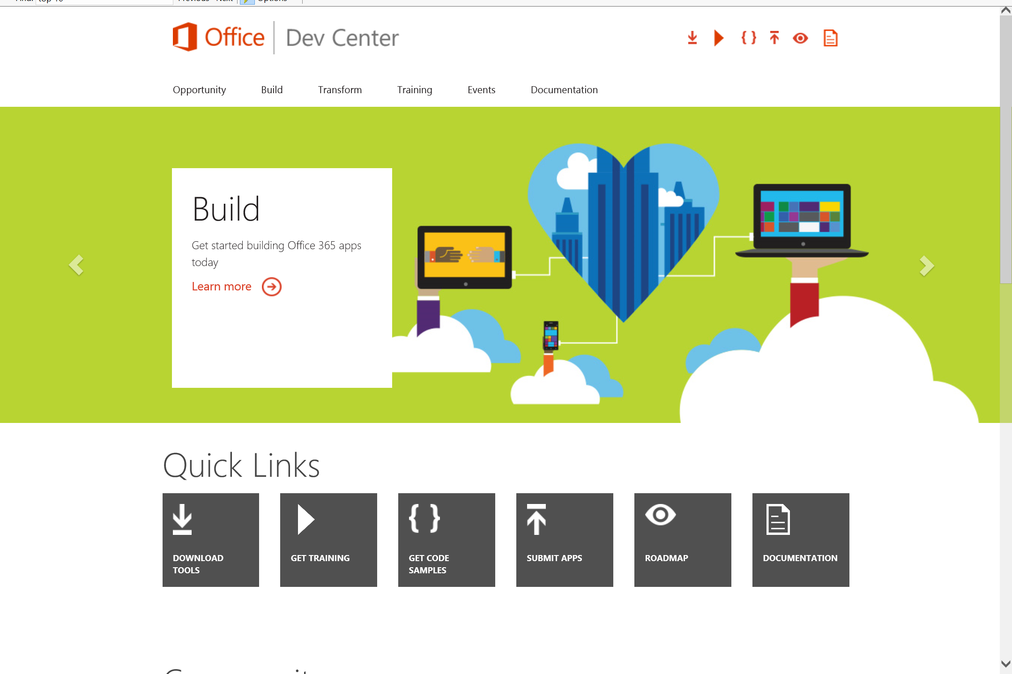
Dev.
Office
.com
One stop shop for Office Developer Platform

Slide 34
Calls to action
Explore our developer center
http://dev.office.com
Jumpstart into our training http://dev.office.com/training
Play with our code samples http://dev.office.com/code-samples
Get answers
http://aka.ms/AskSharePoint
http://aka.ms/AskOffice
Give feedback Drive our roadmap http://aka.ms/OfficeDevFeedback

Slide 35


Transform your code Providing App Model Patterns for common Full Trust Code scenarios
60+ Visual Studio projects Common scenarios
Branding
Site provisioning
Remote event receivers
Large file support
Taxonomy driven navigation
And much more…
Contribute
Open source coming soon!
Developer
Patterns & Practices
aka.ms/OfficeDevPnP

Slide 36
Microsoft Virtual Academy courses
2014
2015
Deep Dive into integrating Office 365 APIs with your mobile device development
Deep dive into the building blocks and services of the SharePoint platform
Deep Dive into integrating Office 365 APIs with your standalone web application development
Introduction to Office 365 Development
Deep Dive into the Office 365 App Model
Deep Dive into Office 365 Development on non-Microsoft Stack
Shipping your Office 365 App to the Office Store
Aug
Sept
Oct
Nov
Dec
Jan
Feb

Slide 37

© 2014 Microsoft Corporation. All rights reserved. Microsoft, Windows, and other product names are or may be registered trademarks and/or trademarks in the U.S. and/or other countries.
The information herein is for informational purposes only and represents the current view of Microsoft Corporation as of the date of this presentation. Because Microsoft must respond to changing market conditions, it should not be interpreted to be a commitment on the part of Microsoft, and Microsoft cannot guarantee the accuracy of any information provided after the date of this presentation. MICROSOFT MAKES NO WARRANTIES, EXPRESS, IMPLIED OR STATUTORY, AS TO THE INFORMATION IN THIS PRESENTATION.

